Slide 1
Capstone Summer 2024: Optimizing User Engagement and Revenue Strategies for Ziga App
Jason Van Wyck
Sponsor: Dahmari Taplin

Slide 2
Project Description
Ziga is a social network app designed specifically for entrepreneurs.
Ziga has been struggling with low user downloads and limited revenue from subscriptions.
Dahmari Taplin, the founder of Ziga, seeks to identify the root cause of these challenges and receive actionable recommendations for improvement.

Slide 3
Business Problems
Unclear Relationship Between Engagement and Revenue
Impact of Key Events and Features
Screen Popularity and Retention
User Behavior Patterns

Slide 4
Methodologies

Slide 5
Hypothesis Testing
Test 1 | Correlation between User Engagement and Revenue Generation | Pearson Correlation Coefficient
Test 2 | Impact of Key Events on User Engagement | t-Test
Test 3 | Screen Popularity and User Retention | Pearson Correlation Coefficient
Test 4 | Differences in Engagement Across Screens | Kruskal-Wallis Test
Test 5 | Effectiveness of Messaging Features | t-Test
Test 6 | User Behavior and App Navigation | Cluster Analysis, ANOVA

Slide 6
Other Analytics Methods and Tools
Analytics Methods | Objectives | Data Sources
Exploratory Data Analysis | To observe data distribution in areas including user acquisition and demographic, user engagement, and monetization. | Ziga’s GA4 database Data range: 8/1/22 to 7/31/24 User engagement data was used for hypothesis testing
Sentiment Analysis | To understand user perceptions of the app based on feedback from the Apple App Store | Users’ reviews from iOS App Store
Comparative Market Analysis | To identify Ziga’s competitors and review their features and strategies | Four competitors on the market

Slide 7
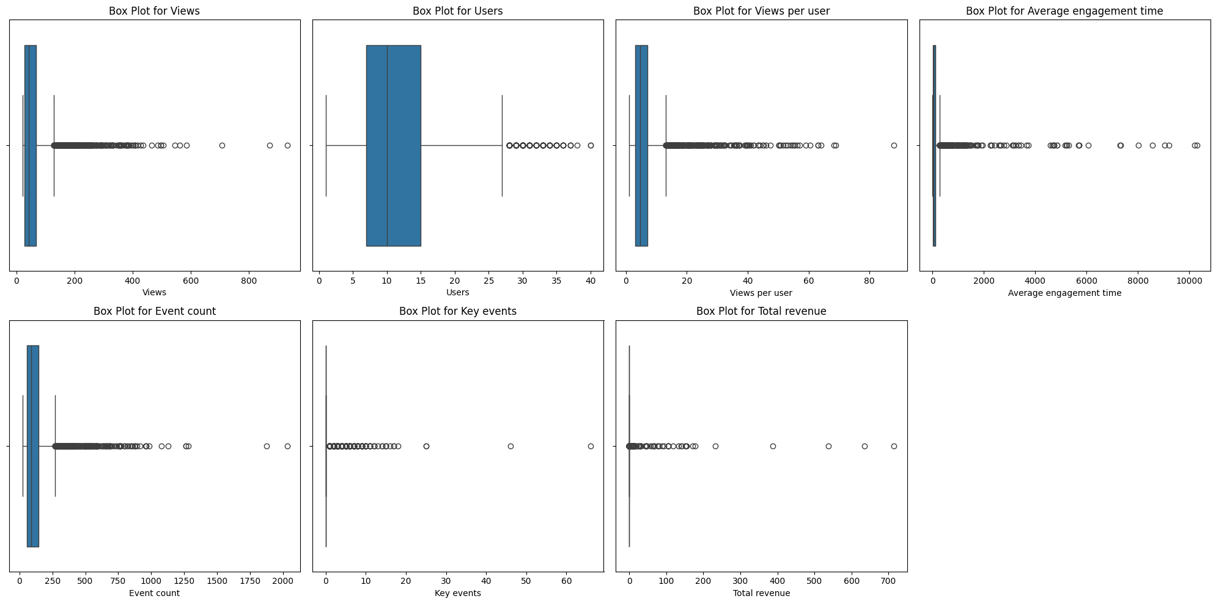
Data Quality
Outliers

Slide 8
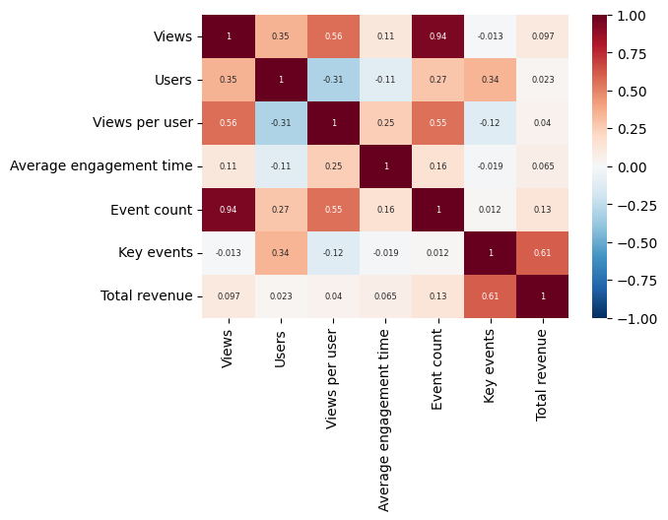
Data Quality
Highly-correlated features

Slide 9
Findings and Results

Slide 10
Hypothesis Testing
There is a significant correlation between:
User engagement and total revenue, suggesting that increased engagement is associated with higher revenue.
The frequency of screen views per user and user retention, implying that more frequent views contribute to better retention.
We observed significant differences in:
Average engagement times were observed across various screen classes, indicating that user engagement varies by screen class.
User behavior between screens with high views but low engagement compared to those with lower views but higher engagement time.
Test | P-value | Outcome
1 | .005 | Statistically significant
2 | .24 | No statistical significance
3 | <.001 | Statistically significant
4 | <.001 | Statistically significant
5 | .13 | No statistical significance
6 | <.001 | Statistically significant

Slide 11
Hypothesis Testing
Key events and messaging features do not show significant effects on engagement, suggesting they might not be the primary drivers of user interaction.
Overall, focusing on engagement optimization and understanding the performance of different screens can lead to better outcomes in user retention and revenue generation.
Test | P-value | Outcome
1 | .005 | Statistically significant
2 | .24 | No statistical significance
3 | <.001 | Statistically significant
4 | <.001 | Statistically significant
5 | .13 | No statistical significance
6 | <.001 | Statistically significant

Slide 12
Monetization
India emerges as the most profitable market for the app.
The United States, while having a larger user base, generates less revenue.
Higher-tier Boost products and longer subscription plans, despite lower purchase volumes, contribute significantly to revenue
Suggesting that users value enhanced features and are willing to pay a premium for them.

Slide 13
Sentiment Analysis
Overall sentiment was predominantly positive sentiment, indicating high customer satisfaction.
Ambiguity was observed in some neutral feedback.
The findings indicate that customers are invested in sharing their genuine, personal experiences with the product.

Slide 14
Comparative Market Analysis
Ziga’s Competitors: Angel List, CoFounders Lab, Founders Nation, Techstars
Recommendations for Ziga
Offer low-cost or free networking services
Hosting free or low-cost virtual events
Enhancing the free tier with more features
Maintaining competitive pricing for premium plans

Slide 15
Reflections

Slide 16
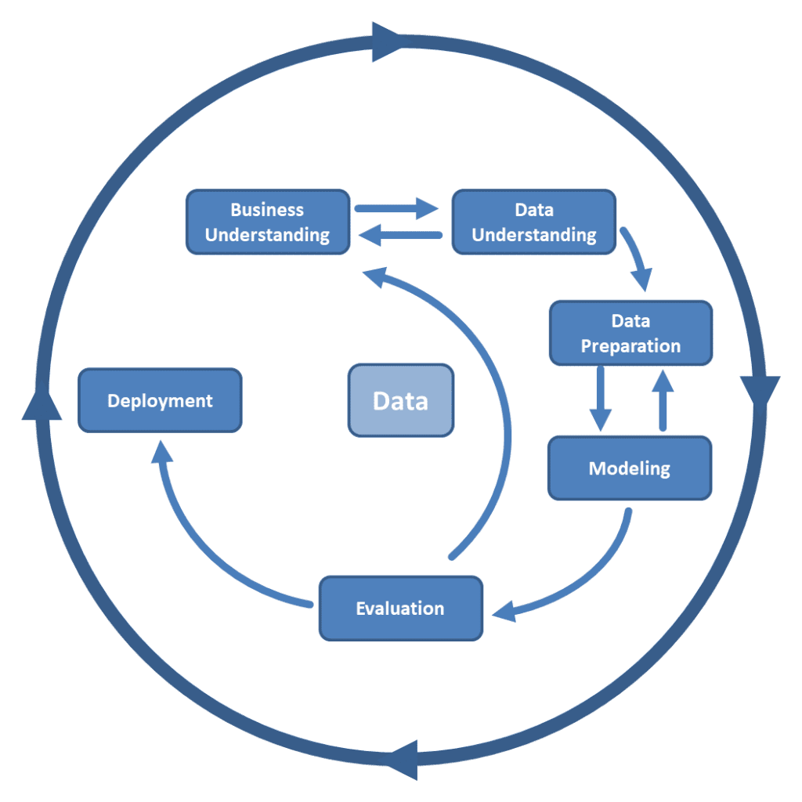
Applying Data Analytics Lifecycle
The more time we spend preparing upfront—by understanding the business, the data, and pre-processing it—the easier the later stages of the CRISP-DM data analytics lifecycle will be.

Slide 17
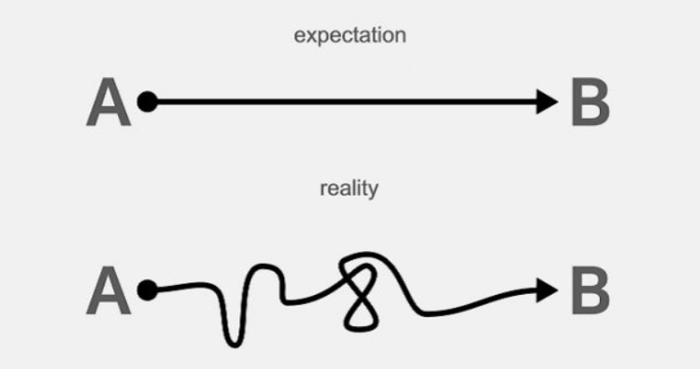
Managing Sponsor’s Expectation
Clear communication
Limitations in reality

